Slide 1

Stephen Mather, GIS Manager, Cleveland Metroparks
@smathermather, svm@clevelandmetroparks.com

Slide 2
OpenDroneMap is an open source toolkit for aerial drone imagery.
It is modern photogrammetry - fully automated matching, digital surface modeling, and mosaicking

Slide 3
In preparation for the robot takeover.

Slide 4
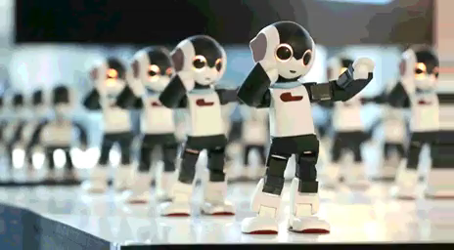
Preparation for the Robot Takeover
Why?
https://imgur.com/gallery/azyruE3

Slide 5
The Future

Slide 6
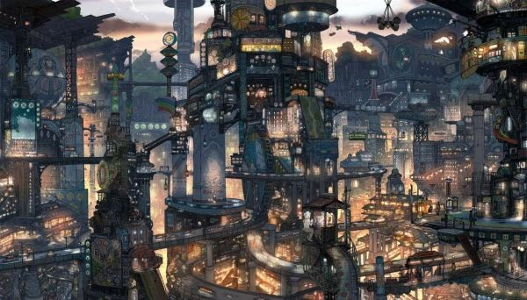
https://s-media-cache-ak0.pinimg.com/736x/61/f0/37/61f037cb982dbd3d9720a107e9373b01.jpg

Slide 7
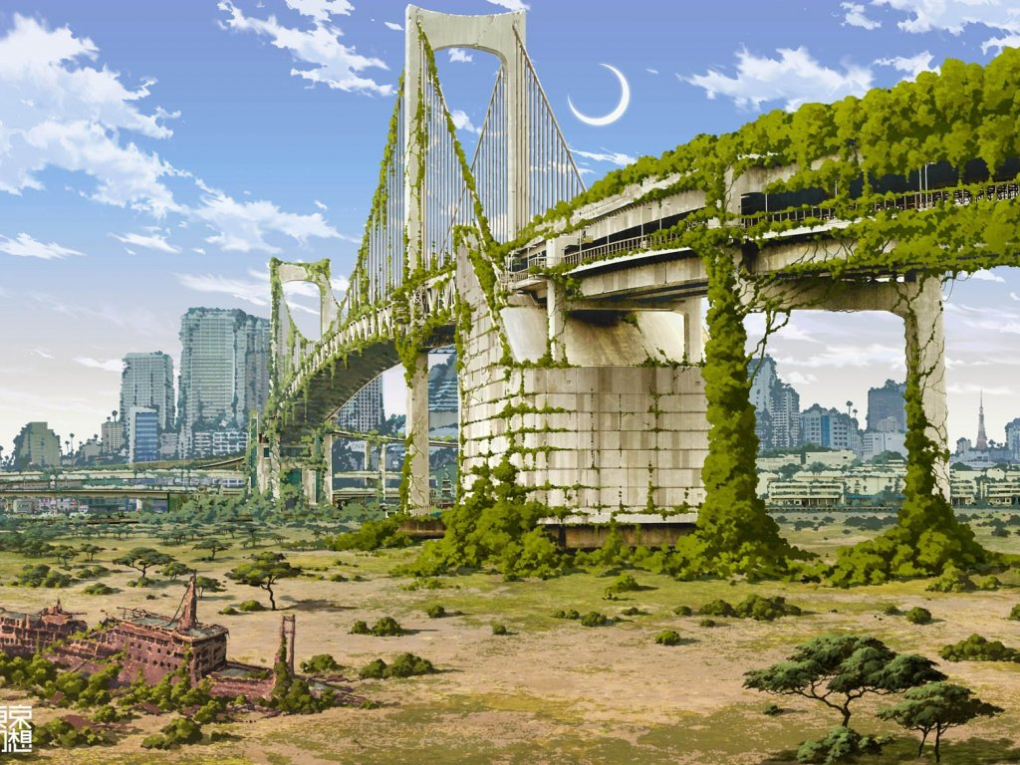
https://www.walldevil.com/6554-bridges-cities-crescent-moon-fantasy-futuristic-japan-landscapes-moss-nature-postapocalyptic-rainbow-bridge-ruins-ships-tokyo-tokyogenso-vehicles.html

Slide 8
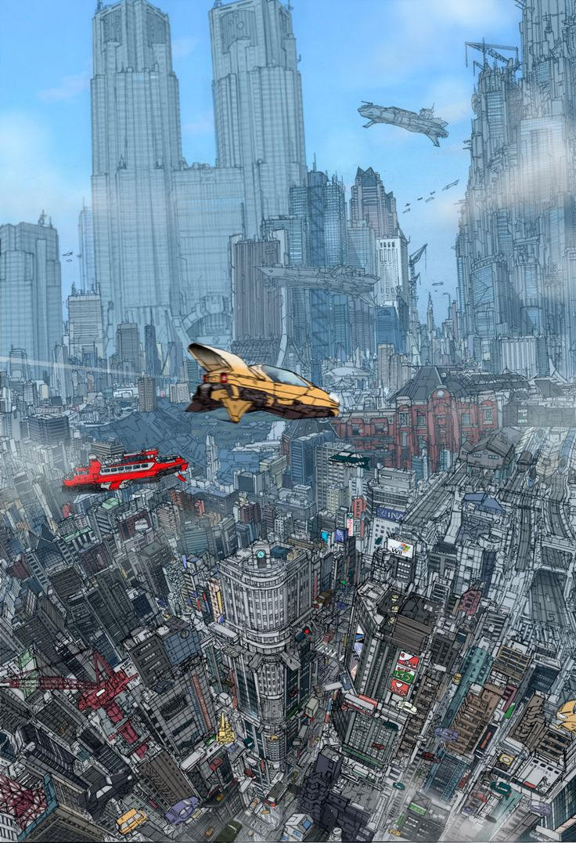
https://s-media-cache-ak0.pinimg.com/736x/36/a5/e7/36a5e797df79b8ed4931d40dc75c0084.jpg

Slide 9
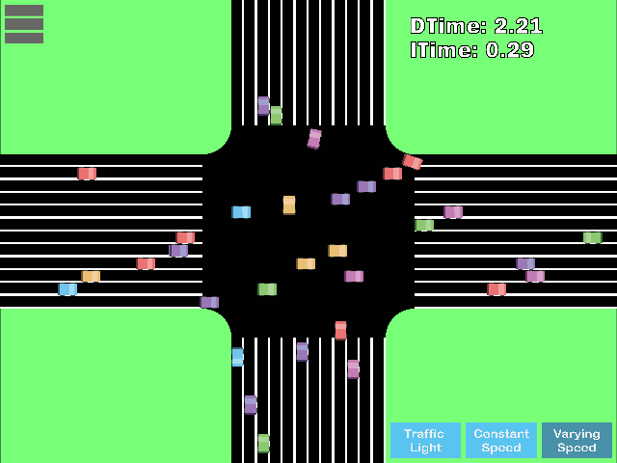

Slide 10
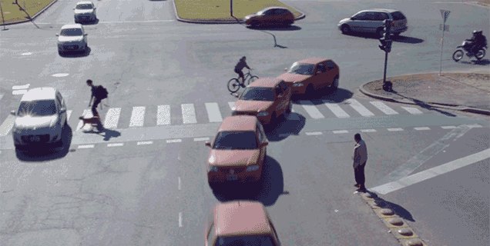

Slide 11
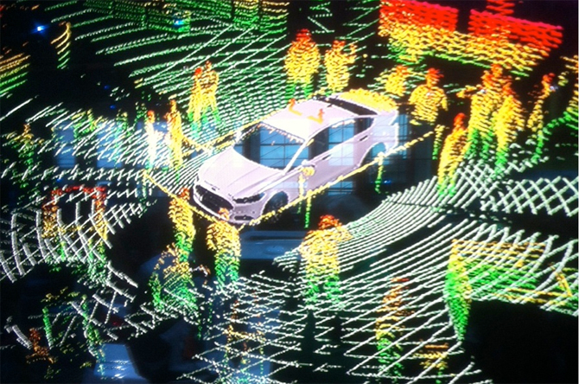

Slide 12
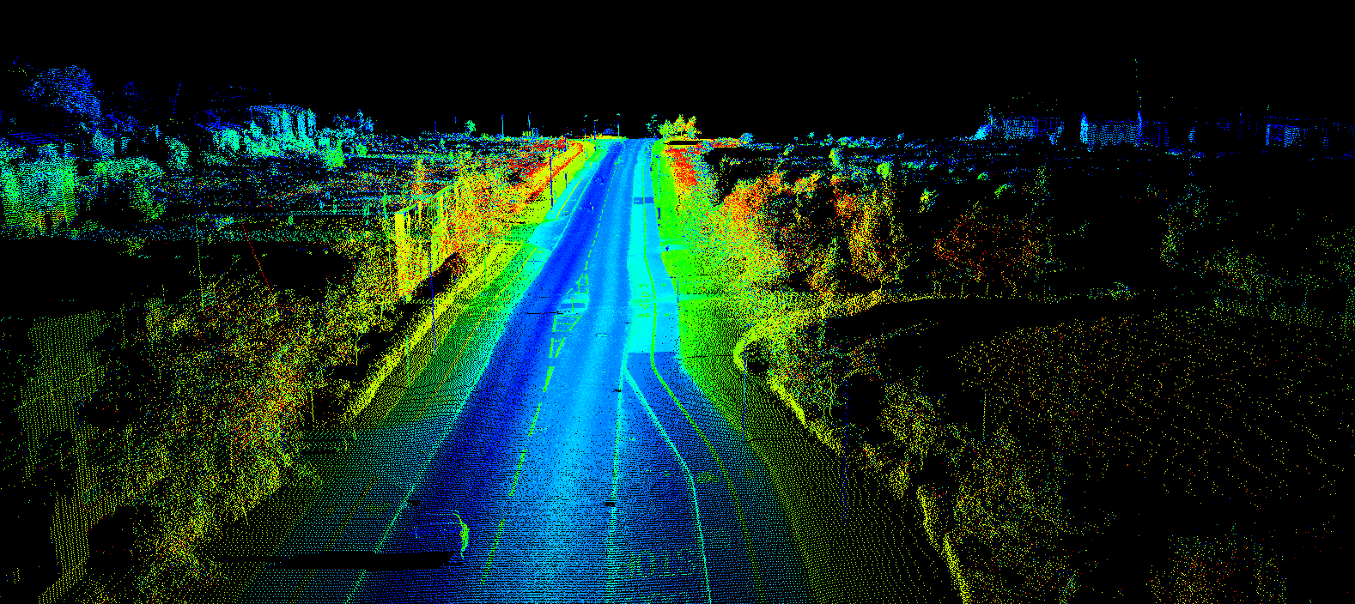
http://www.renishaw.com/media/img/gen/9a5511617ef7479a8d3ddc0917dc5b6d.png

Slide 13
OpenDroneMap is an open source toolkit for aerial drone imagery.
It is modern photogrammetry - fully automated matching, digital surface modelling, and mosaicking
Platform vs. Toolkit

Slide 14
Origins
Computer Vision
Photogrammetry
Notes:
OpenDroneMap originates from Computer Vision, i.e. how do we enable computers to navigate and understand the world.
It depends on stereo vision much like we do to make sense of the world in 3D

Slide 15
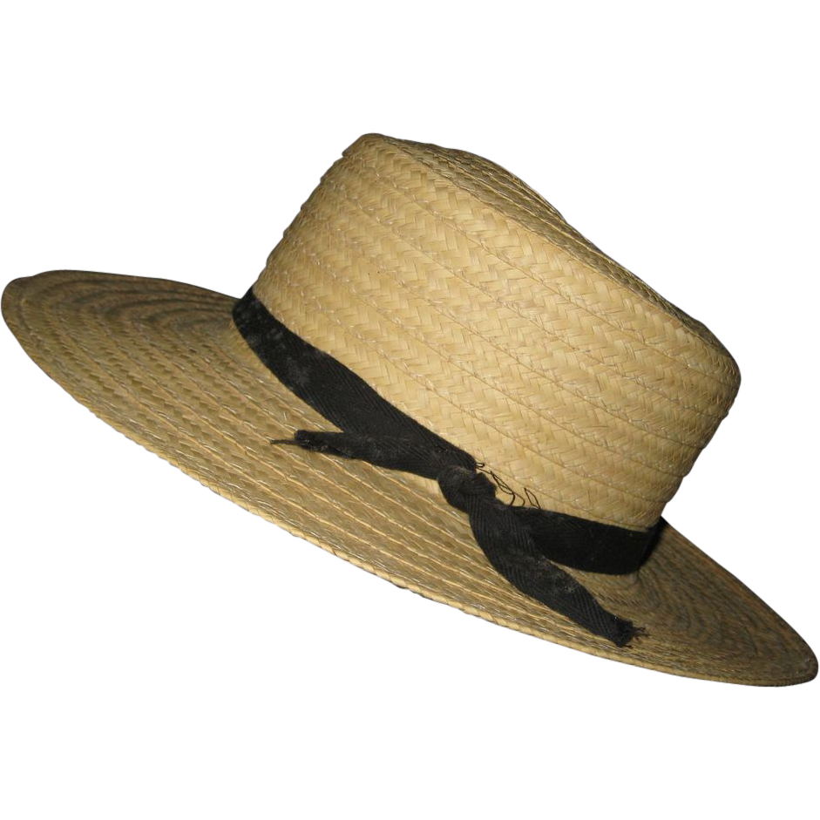
Purposes
Ecology
Humanitarian
Participatory creation of data for the public good
http://image0-rubylane.s3.amazonaws.com/shops/suzanstreasures/VCx20-x201402.1L.jpg
Notes:
OpenDroneMap originates from Computer Vision, i.e. how do we enable computers to navigate and understand the world.
It depends on stereo vision much like we do to make sense of the world in 3D

Slide 16
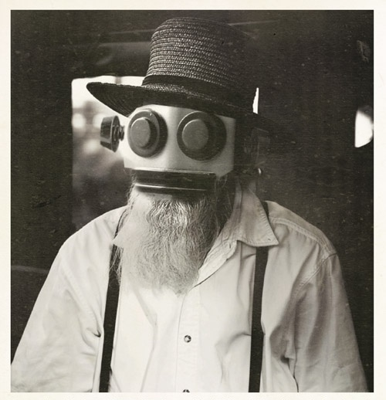
This complicates my robot narrative…
https://s-media-cache-ak0.pinimg.com/736x/a7/9a/73/a79a731eea0f09d09c012856914e74dc.jpg

Slide 17
ODM and the photogrammetric process
Structure from Motion
Point Cloud Densification
Poisson Surface Reconstruction
Multi-View Stereo Texturing
Orthophoto Generation

Slide 18
ODM and the photogrammetric process
Structure from Motion
Point Cloud Densification
Poisson Surface Reconstruction
Multi-View Stereo Texturing
Orthophoto Generation

Slide 19
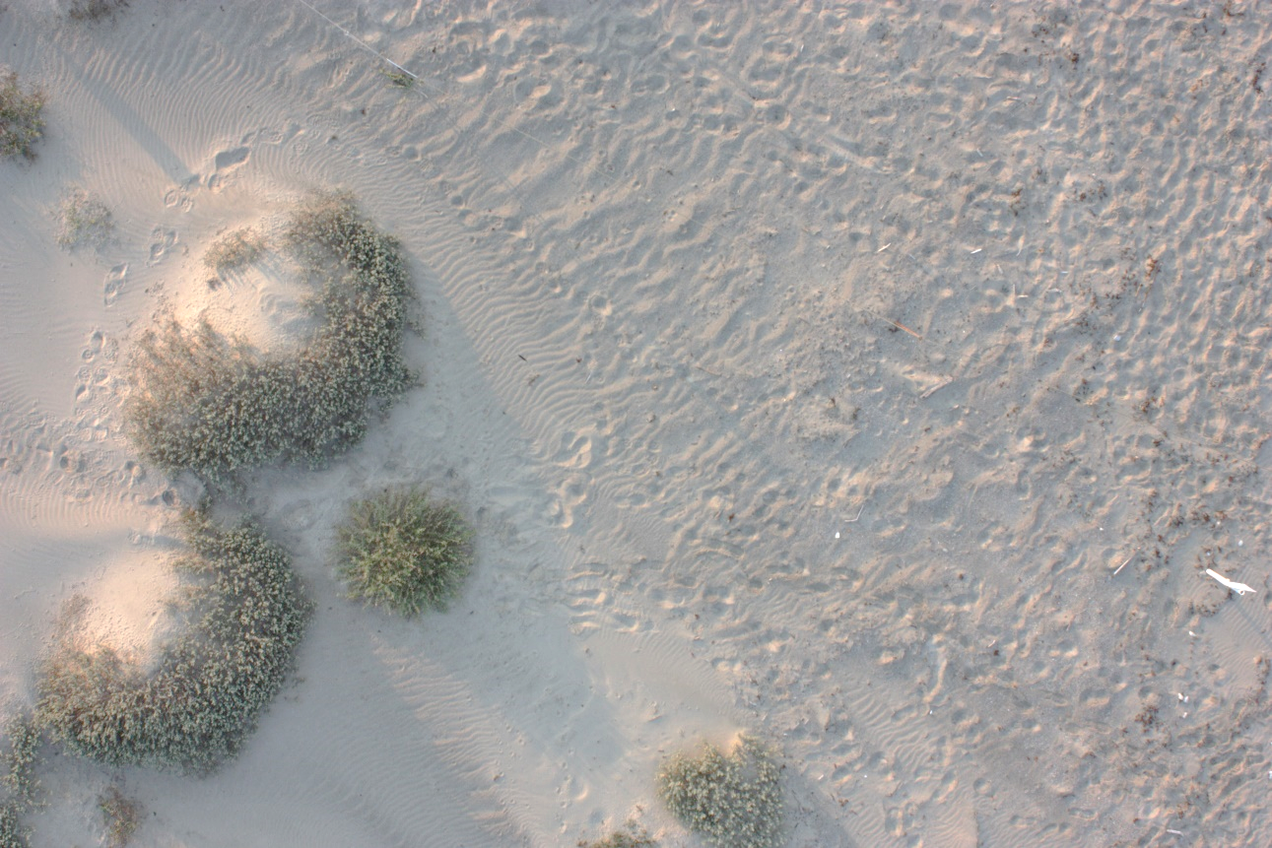
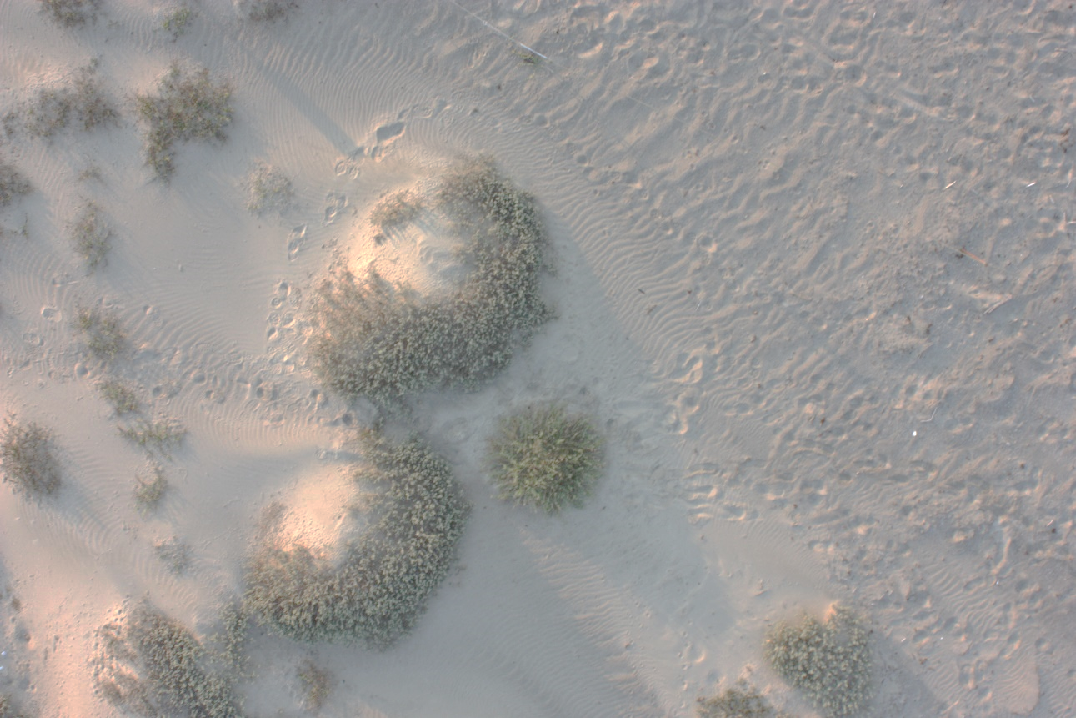
Structure from Motion
Matches features extracted from images with overlap
Credit: Michelle Tobias

Slide 20
Photogrammetry Process
Structure from Motion
Point Cloud Densification
Poisson Surface Reconstruction
Multi-View Stereo Texturing
Orthophoto Generation

Slide 21
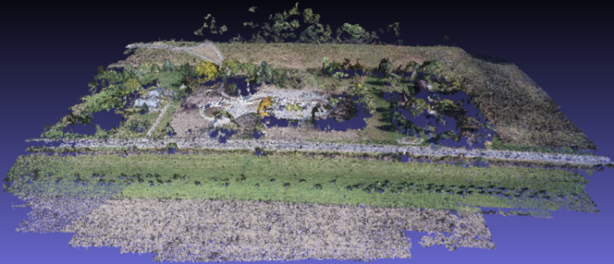
Point Cloud from Matching
Notes:
(Photogrammetrically Derived Point Cloud)

Slide 22
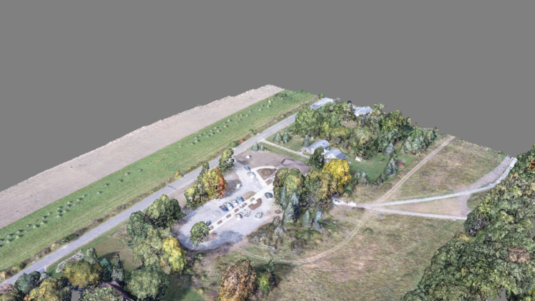
Dense Point Cloud from finding all matches

Slide 23
Photogrammetry Process
Structure from Motion
Point Cloud Densification
Poisson Surface Reconstruction
Multi-View Stereo Texturing
Orthophoto Generation

Slide 24
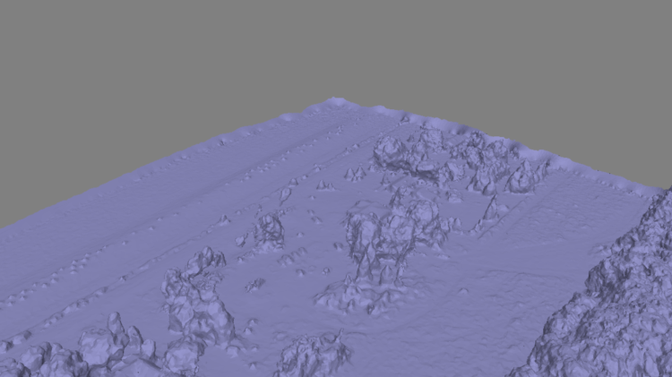
Mesh
Notes:
Uses the Point Cloud Library (PCL), followed by mesh decimation

Slide 25
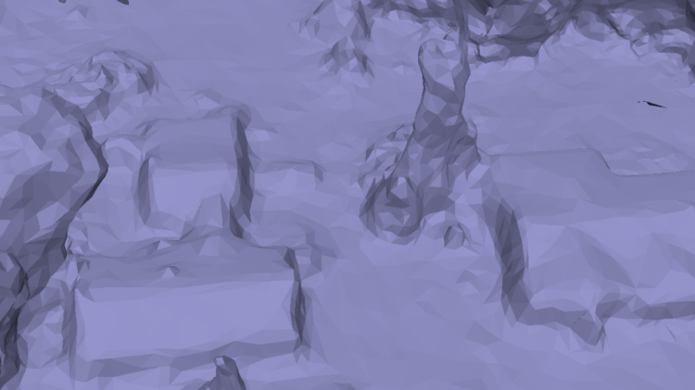
Mesh
Notes:
Uses the Point Cloud Library (PCL), followed by mesh decimation

Slide 26
Photogrammetry Process
Structure from Motion
Point Cloud Densification
Poisson Surface Reconstruction
Multi-View Stereo Texturing
Orthophoto Generation

Slide 27
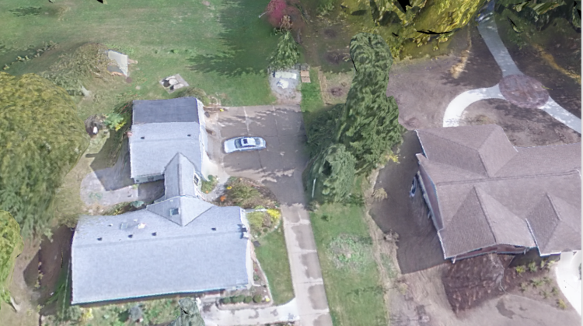
Texturing

Slide 28
Photogrammetry Process
Structure from Motion
Point Cloud Densification
Poisson Surface Reconstruction
Multi-View Stereo Texturing
Orthophoto Generation

Slide 29
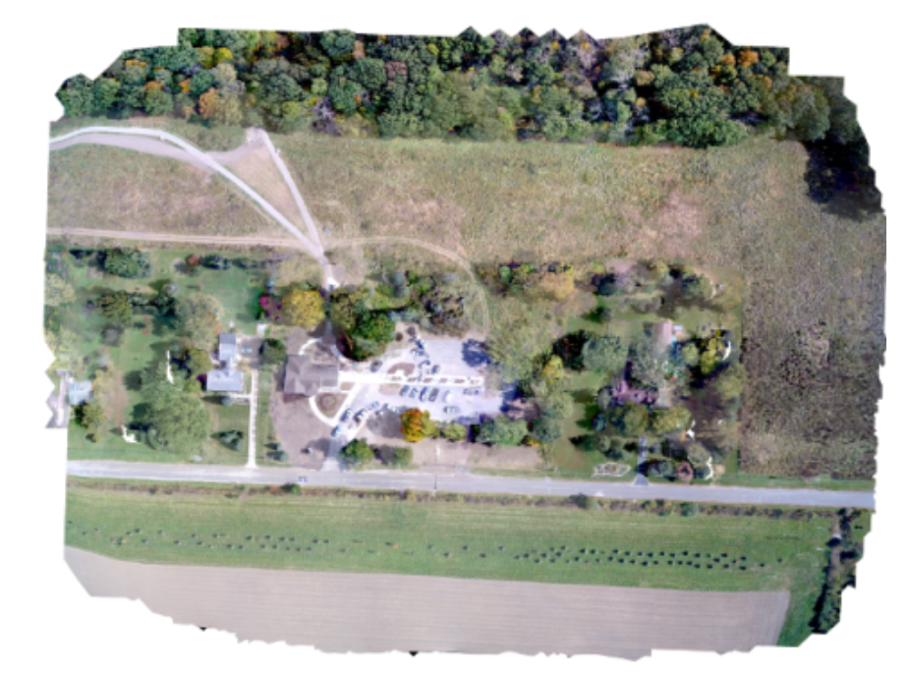
Orthophoto Generation

Slide 30
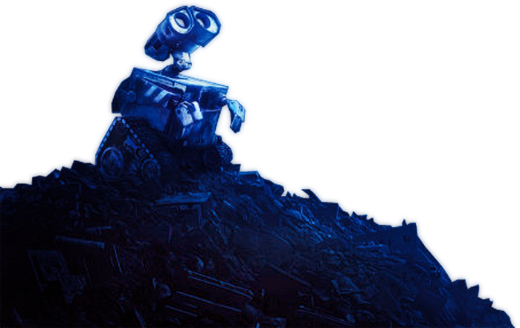
Questions you may be asking:
This is great, Steve. How do I get started in collecting the necessary datasets for the robot takeover?
https://photoshopstar.com/graphics/wall-e-cartoon-style-wallpaper/

Slide 31
How to Use OpenDroneMap

Slide 32
Installation
There are many ways to install ODM:
Natively using Ubuntu 14.04 or later (or with Virtual Machine via vagrant)
Linux, MacOS or Windows, by installing Docker
Via the above methods but with a Web-based GUI called WebODM
See project: OpenDroneMap.org

Slide 33
Usage
Command line tool
Portable OpenStreetMap (POSM)
WebODM
API
API Docs: https://opendronemap.github.io/WebODM/

Slide 34


Slide 35
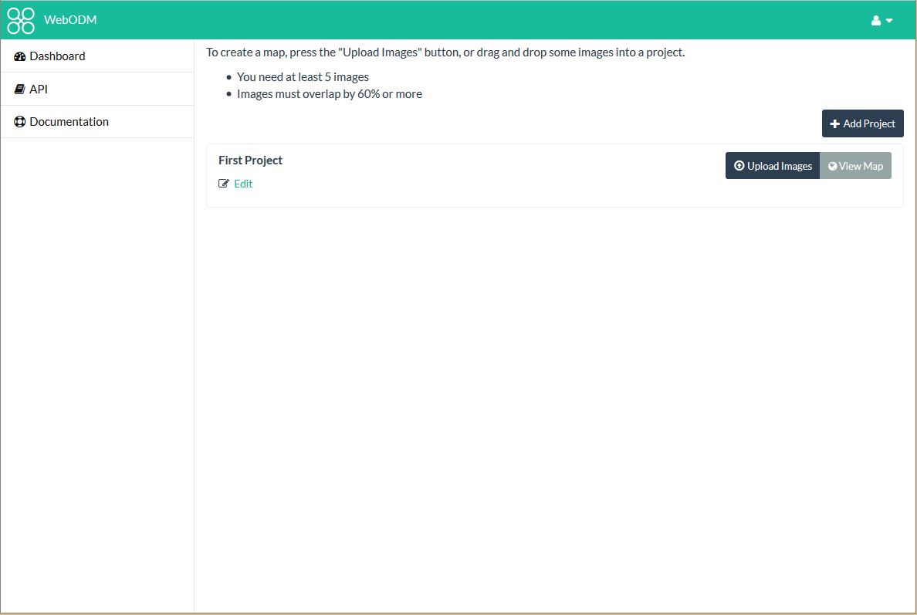

Slide 36
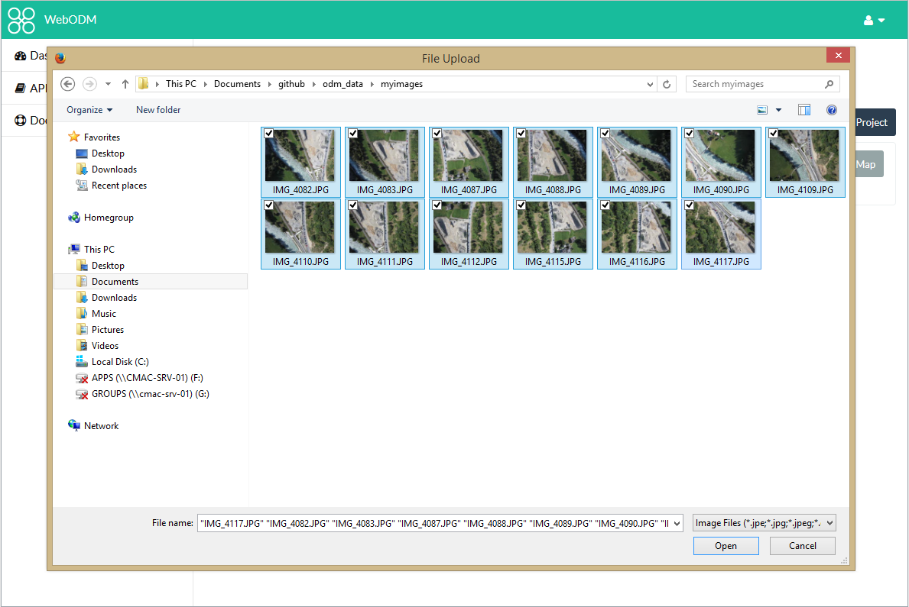

Slide 37
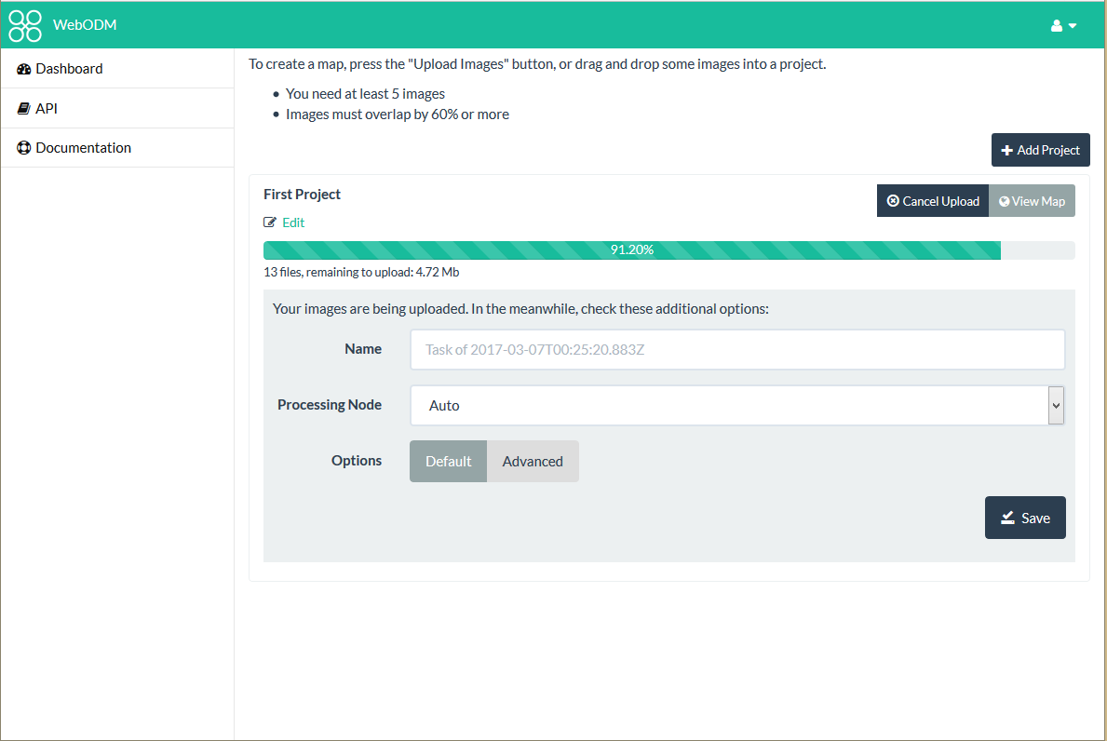

Slide 38
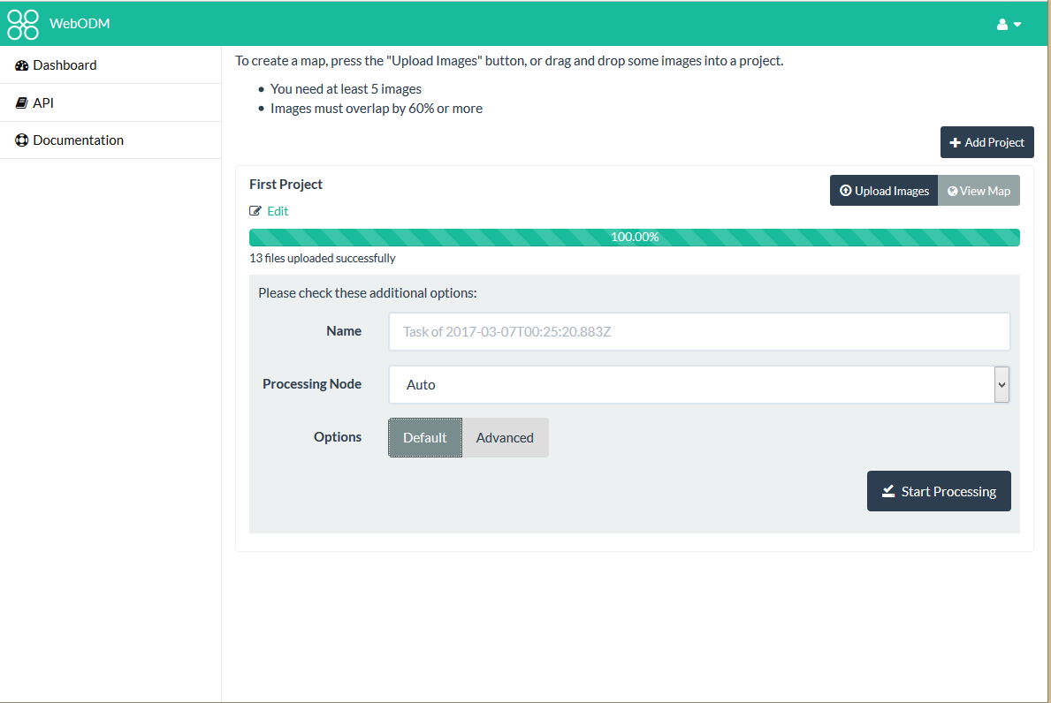

Slide 39
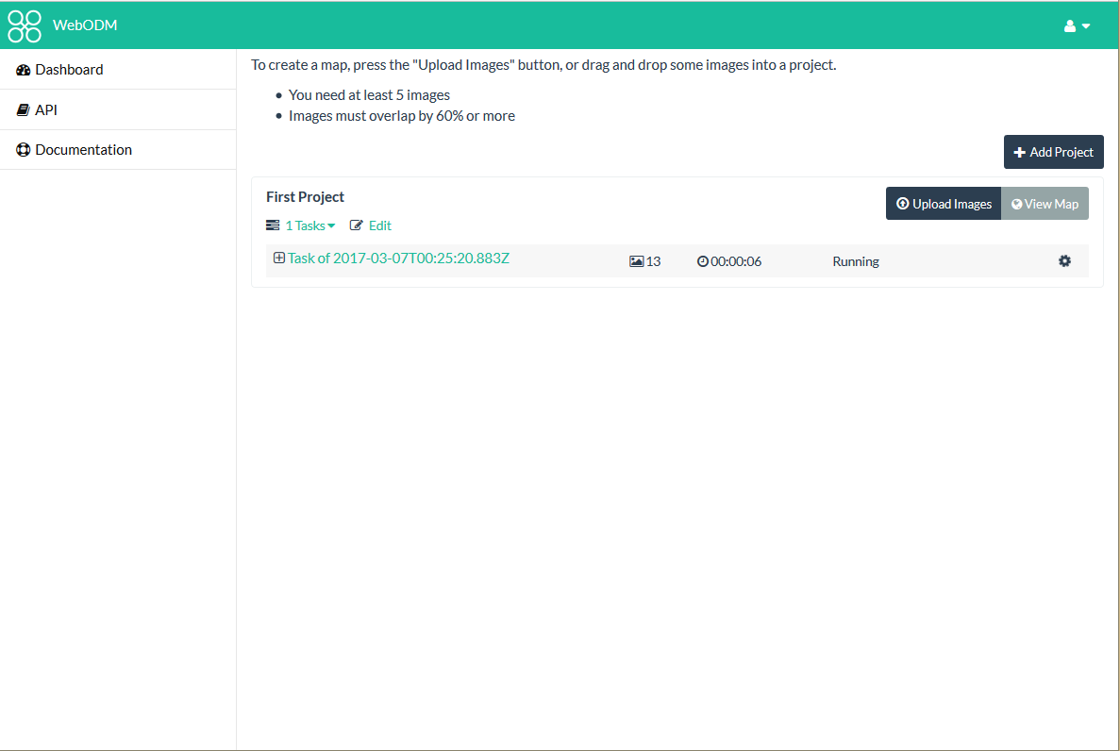

Slide 40
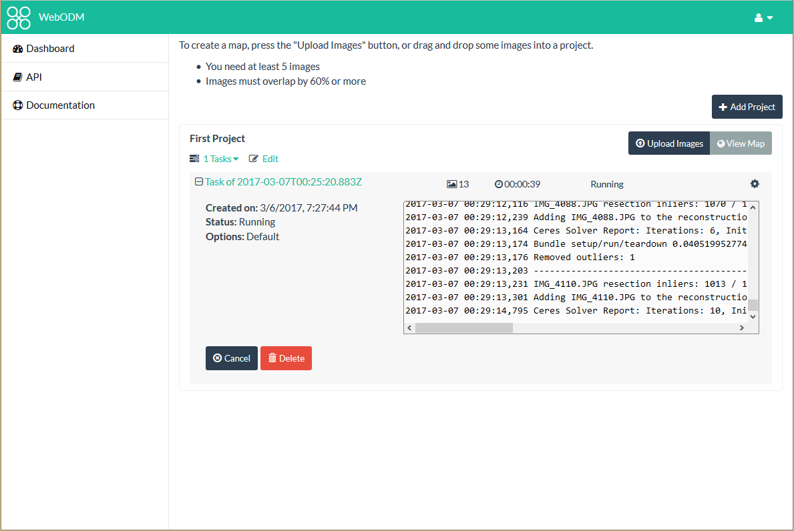

Slide 41
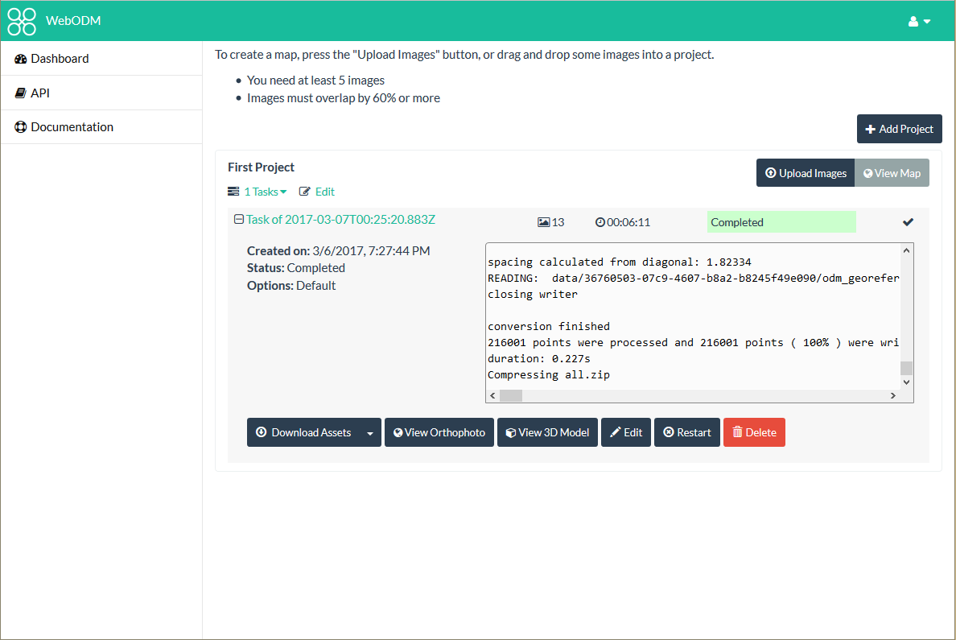

Slide 42
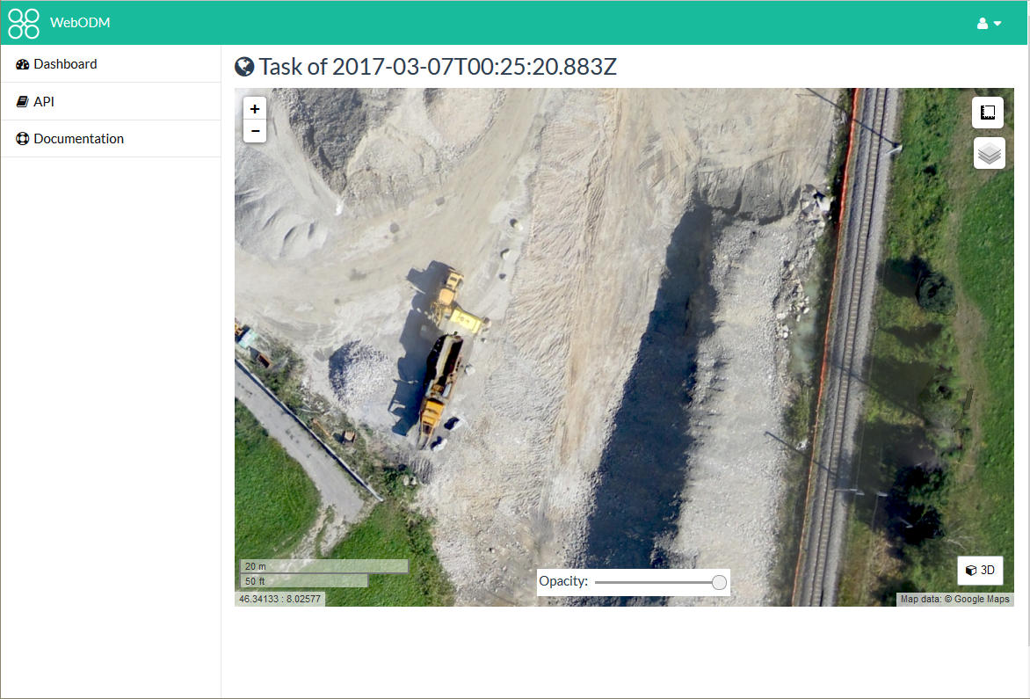

Slide 43
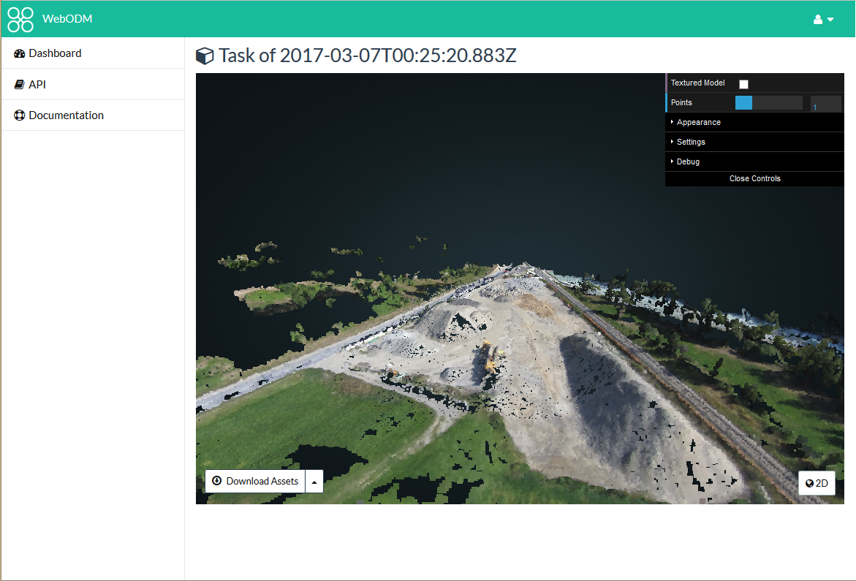

Slide 44
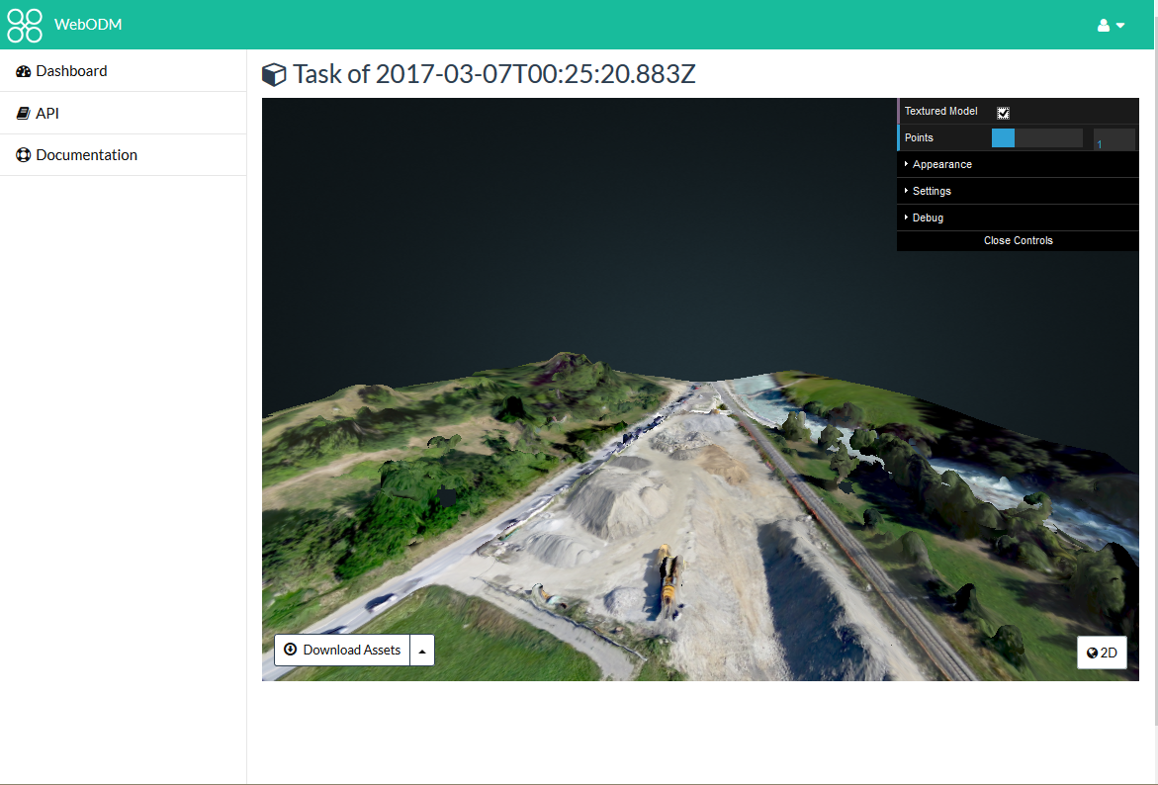

Slide 45
Funding and Future

Slide 46
Funding
Cleveland Metroparks
American Red Cross
Integration with Portable OpenStreetMap (POSM)
Humanitarian Innovation Fund
Make ODM Easier to Use
Make the products from it better / more accurate

Slide 47
OpenDroneMap: Future
Quality and robustness improvements
Scalability
Reduce memory footprint
Data Partitioning
Analysis
Add automated DTM extraction
Classification
Mesh improvements

Slide 48
DTM Extraction
Near future

Slide 49
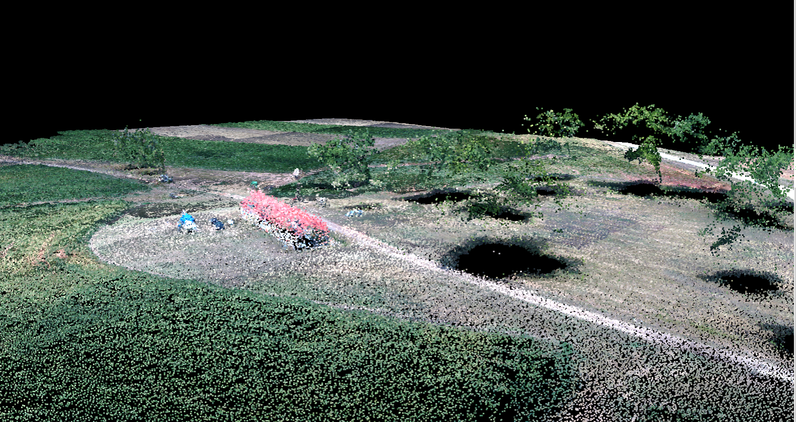
Midpines, flown by NextGen Air Transportation Center (NGAT) access to the data through collaboration with Center for Geospatial Analytics at NCSU

Slide 50
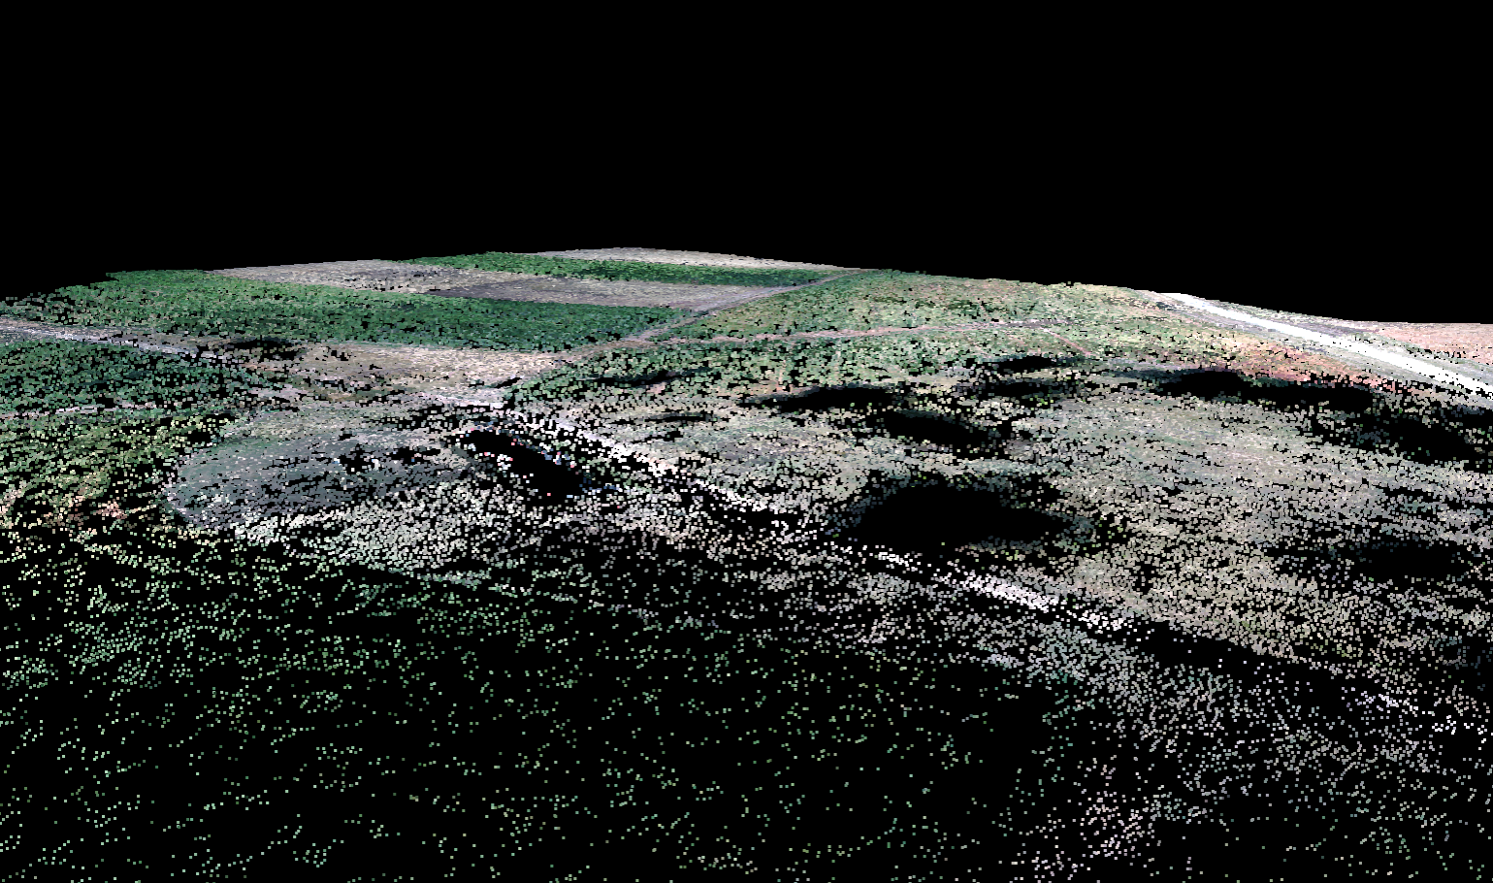
Midpines, flown by NextGen Air Transportation Center (NGAT) access to the data through collaboration with Center for Geospatial Analytics at NCSU

Slide 51
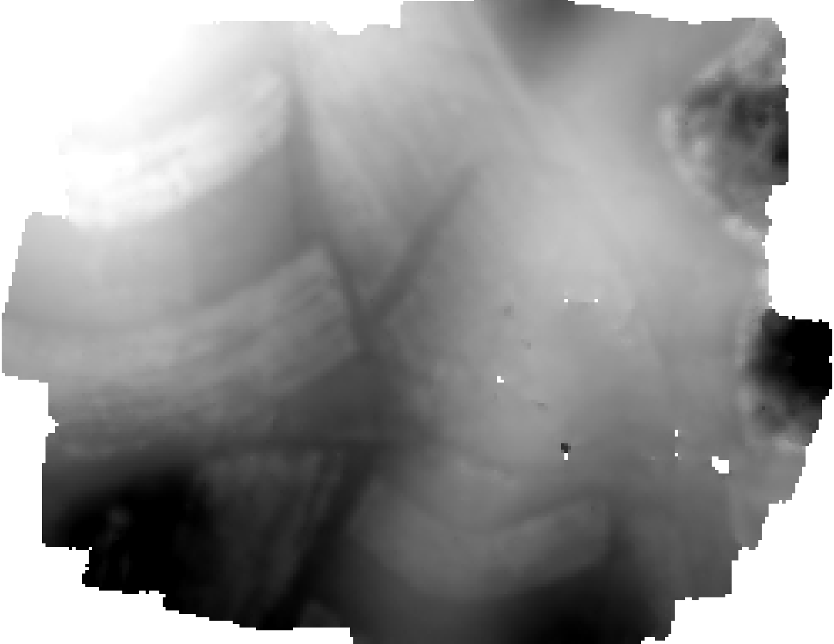
Midpines, flown by NextGen Air Transportation Center (NGAT) access to the data through collaboration with Center for Geospatial Analytics at NCSU

Slide 52
Near-term improvements
Quality reporting and robustness improvements
Incremental optimizations
Large-scale pipeline

Slide 53
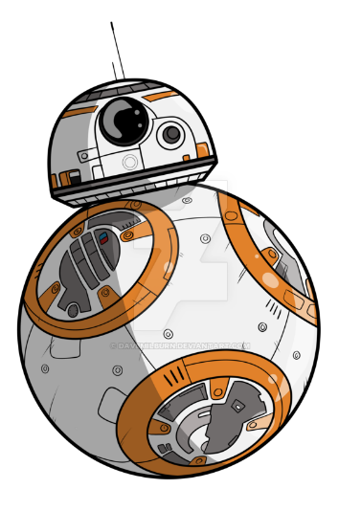
Quality reporting and robotness improvements
Add reporting system to OpenSfM
Collect metadata on Structure from Motion Process
Number of matches, Matching graph between images, Number of reconstructed images and points, Histogram of reprojection errors, Memory Usage, etc.
Improve Robotness
Analyze and classify failures
Improve results on difficult datasets
Establish test datasets for ongoing testing
http://davemilburn.deviantart.com/art/BB8-586862785

Slide 54
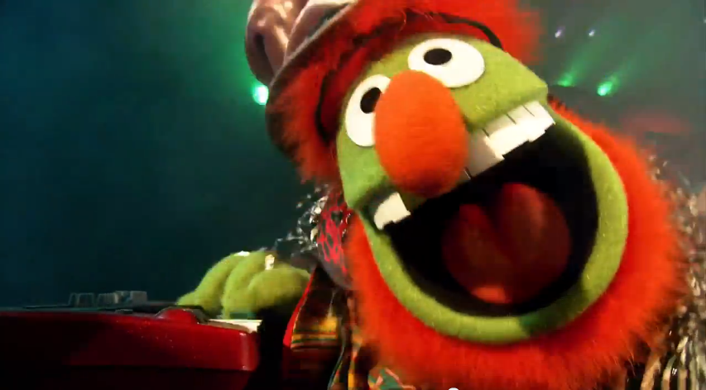
Large-scale pipelineor breaking datasets into bite-size pieces
Split large numbers of images into smaller groups
Run OpenSfM reconstruction on each subgroup
Align and transform those groups to each other using matching features between the groups

Slide 55
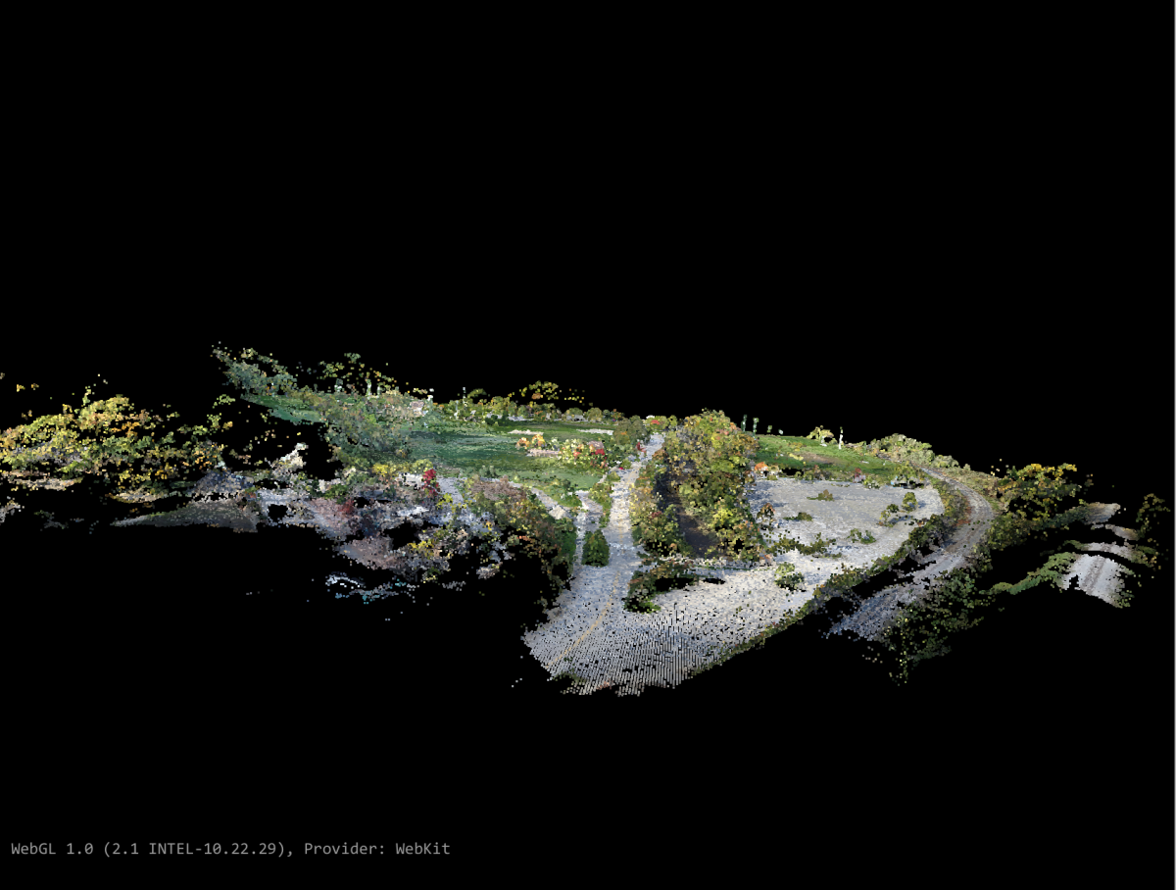
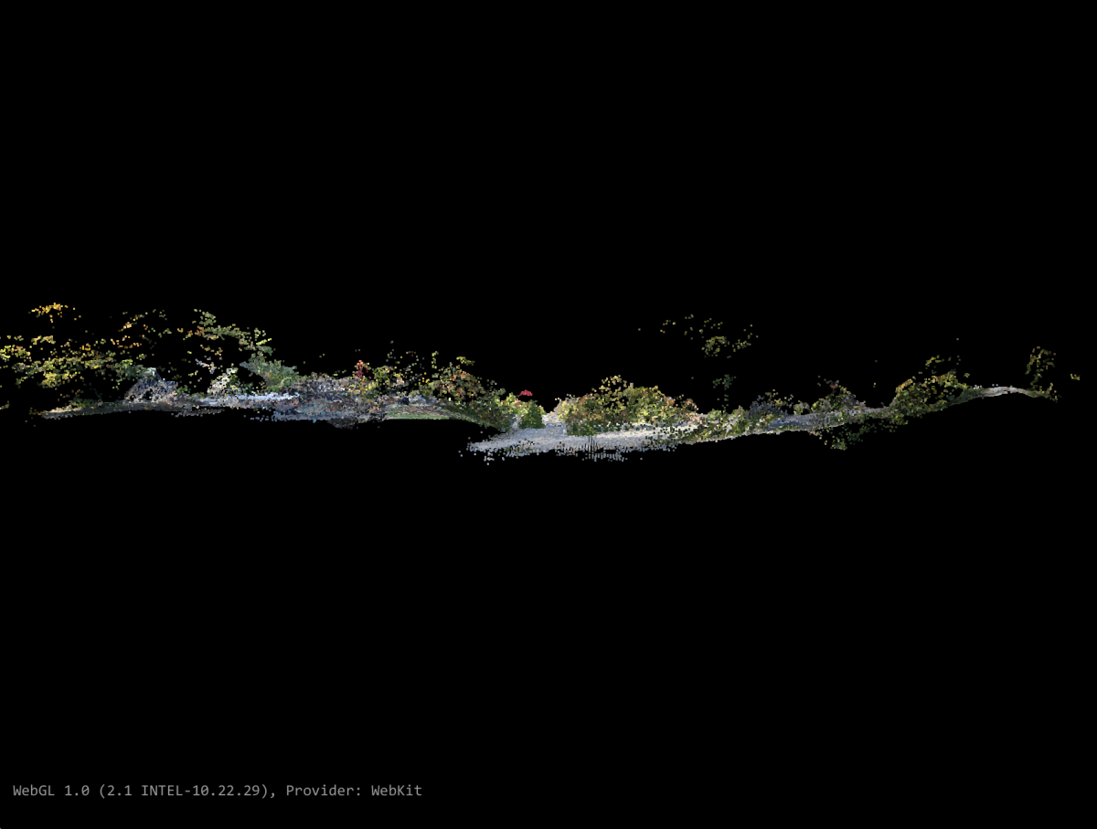
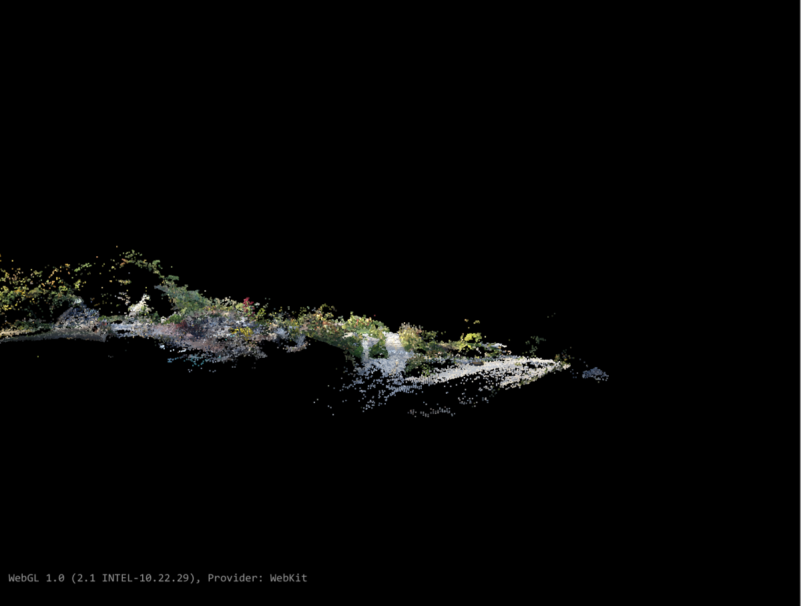
Large-scale pipelineor breaking datasets into bite-size pieces

Slide 56
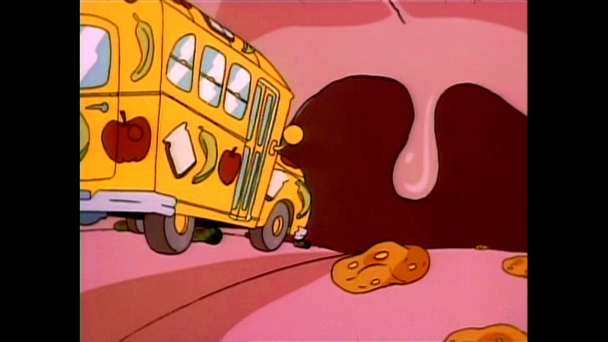
Incremental optimizations or what happens after it’s down the gullet
Improve processor use
Cascade Hashing¹ matching
or
Bag of Words²
Improved Memory Use:
Improved correspondence graph data structures
SLAM-like pose-graph methods for global adjustment of camera position
[1] Jian Cheng, Cong Leng, Jiaxiang Wu, Hainan Cui, Hanqing Lu; The IEEE Conference on Computer Vision and Pattern Recognition (CVPR), 2014, pp. 1-8
[2] Michal Havlena, Konrad Schindler; VocMatch: Efficient Multiview Correspondence for Structure from Motion; Institute of Geodesy and Photogrammetry, ETH Zurich, Switzerland

Slide 57
WebODM: Future
DEM display
Volumetric Measurements
Mission Planning
Mobile App for autonomous flight
QGIS integration
Integration with Entwine + Greyhound
Integration with OpenAerialMap

Slide 58
Use Cases

Slide 59
Small scale use case

Slide 60
Fort Hill Steps

Slide 61
Fort Hill Steps

Slide 69
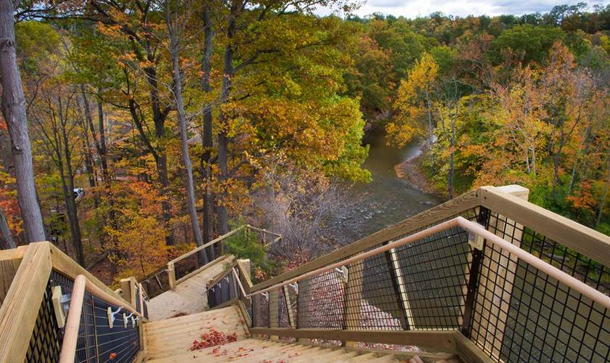

Slide 70
Large Scale Use Case

Slide 71
Zanzibar Mapping Initiative

Slide 72
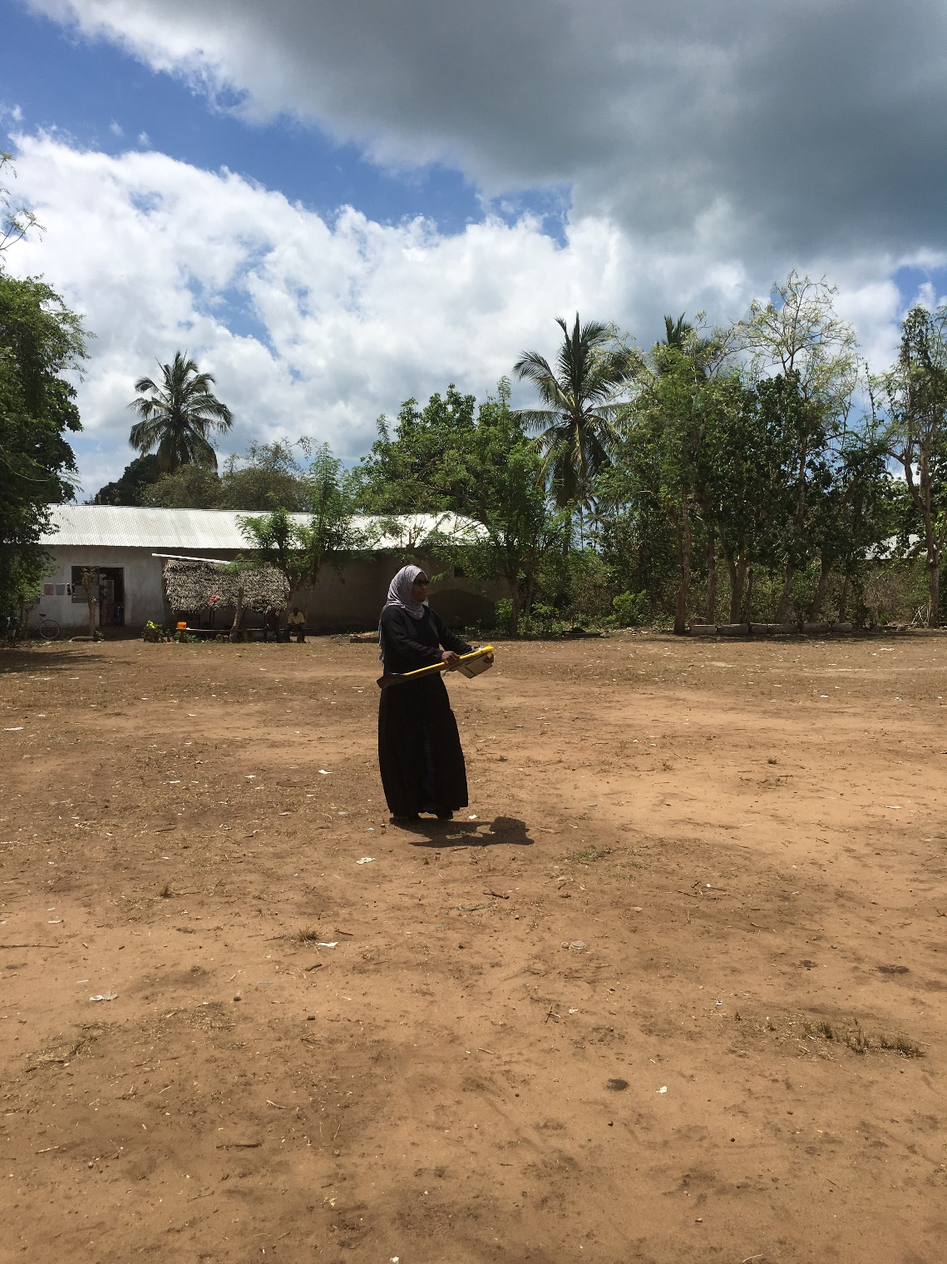
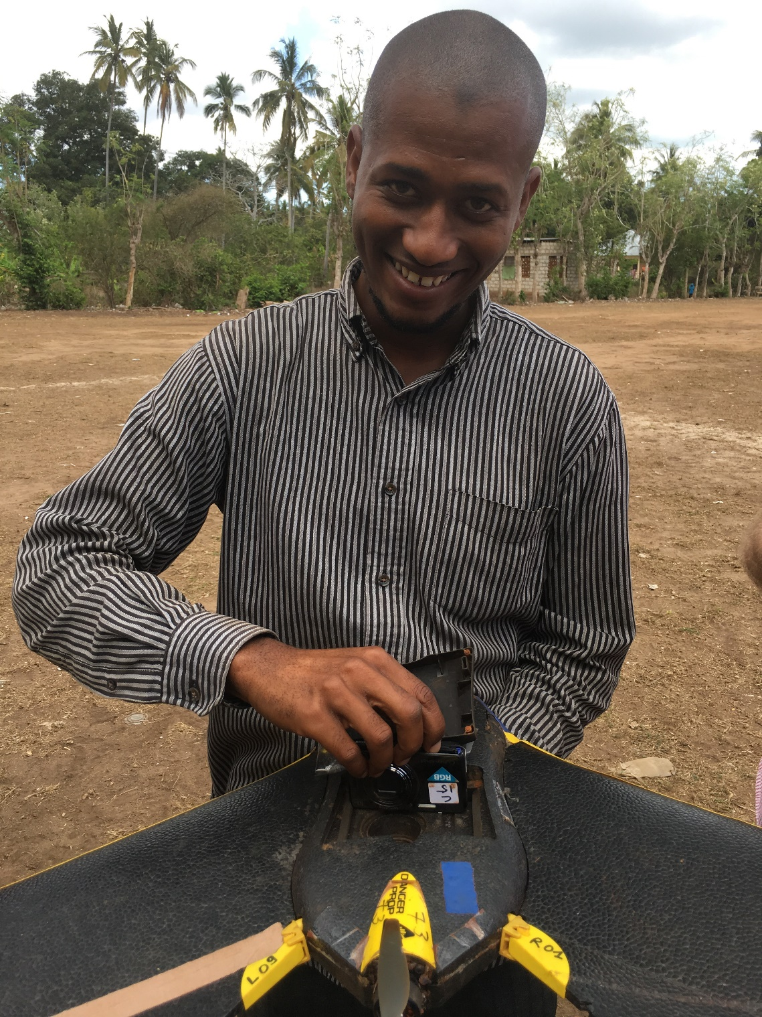

Slide 73
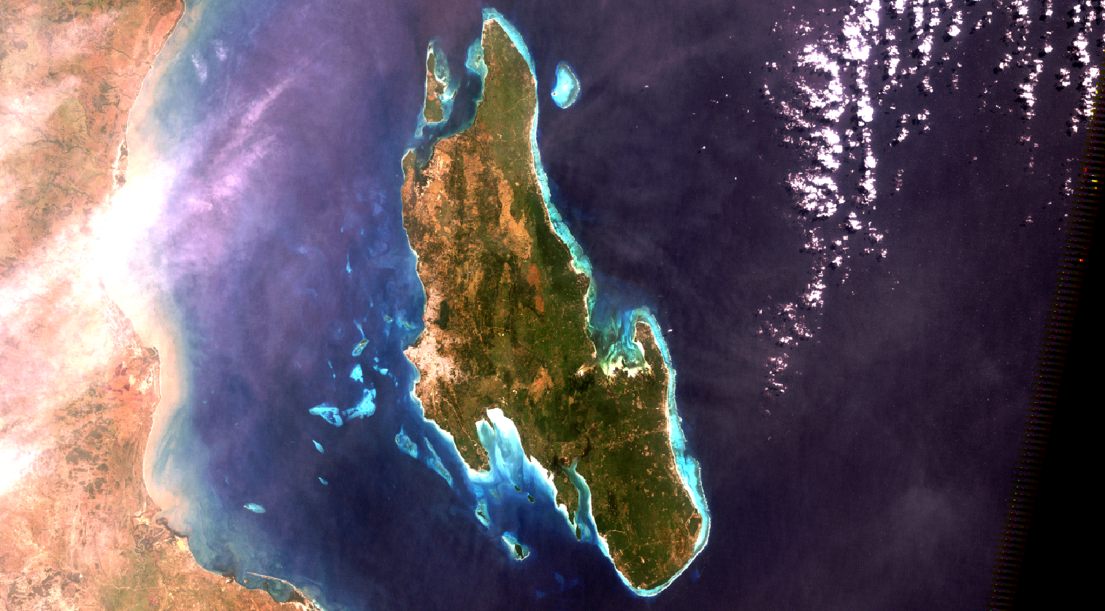

Slide 74
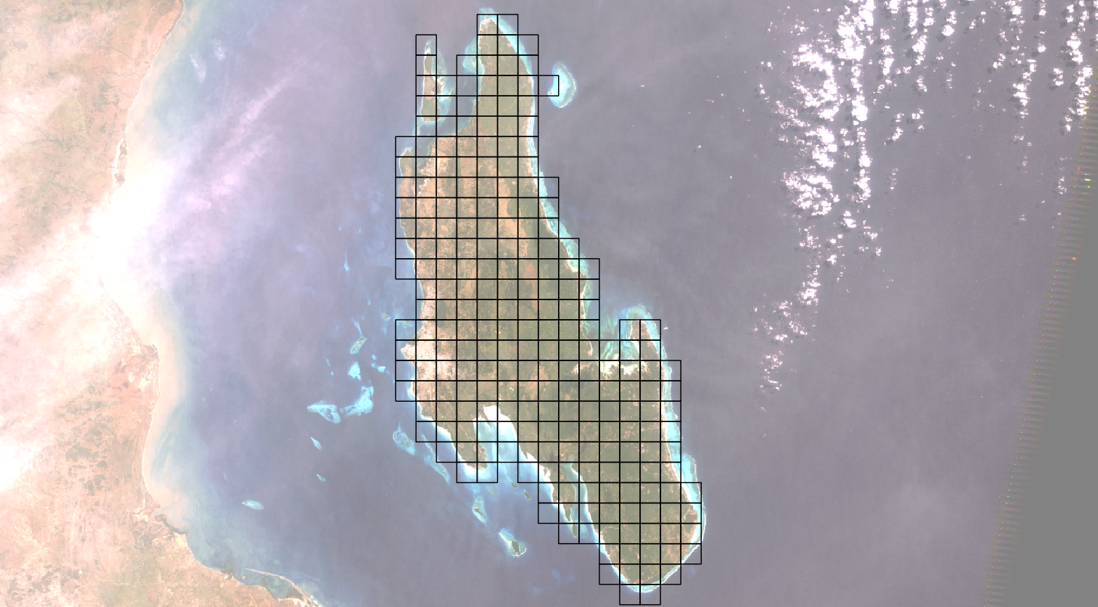

Slide 75
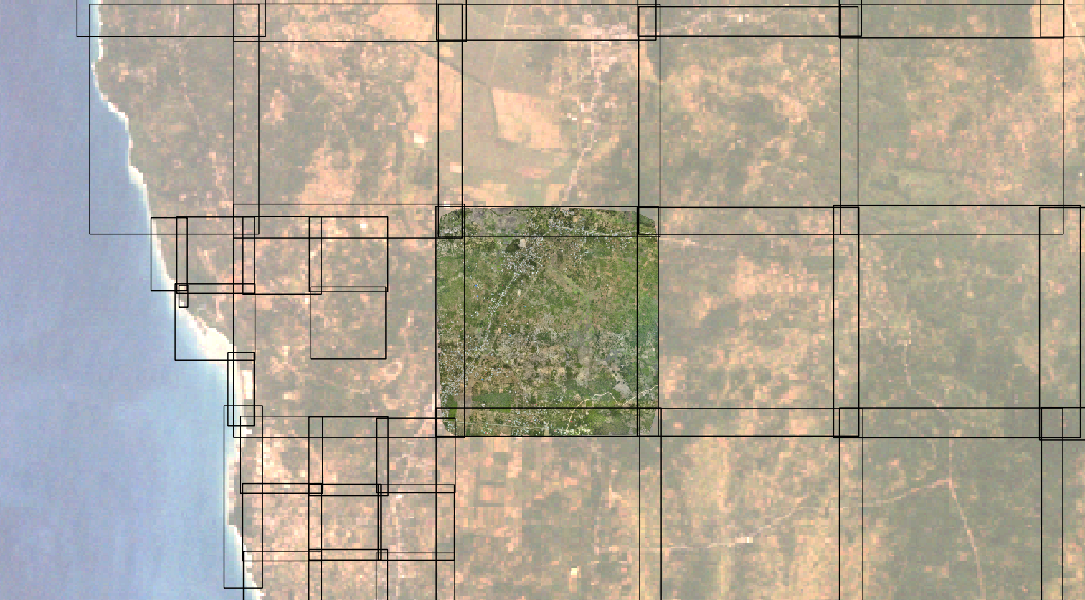

Slide 76
Compounding Z error across large landscape

Slide 77
Corrected Z error across large landscape

Slide 78
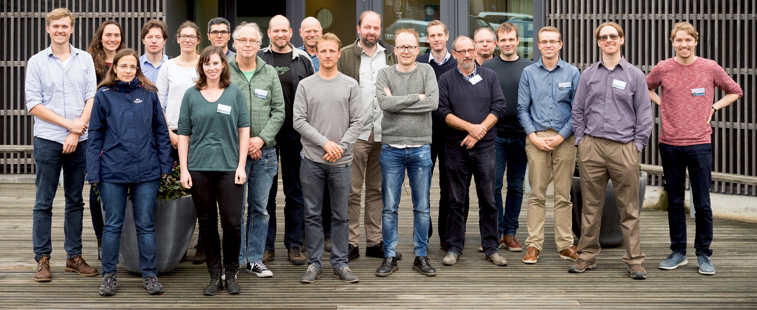

Slide 79
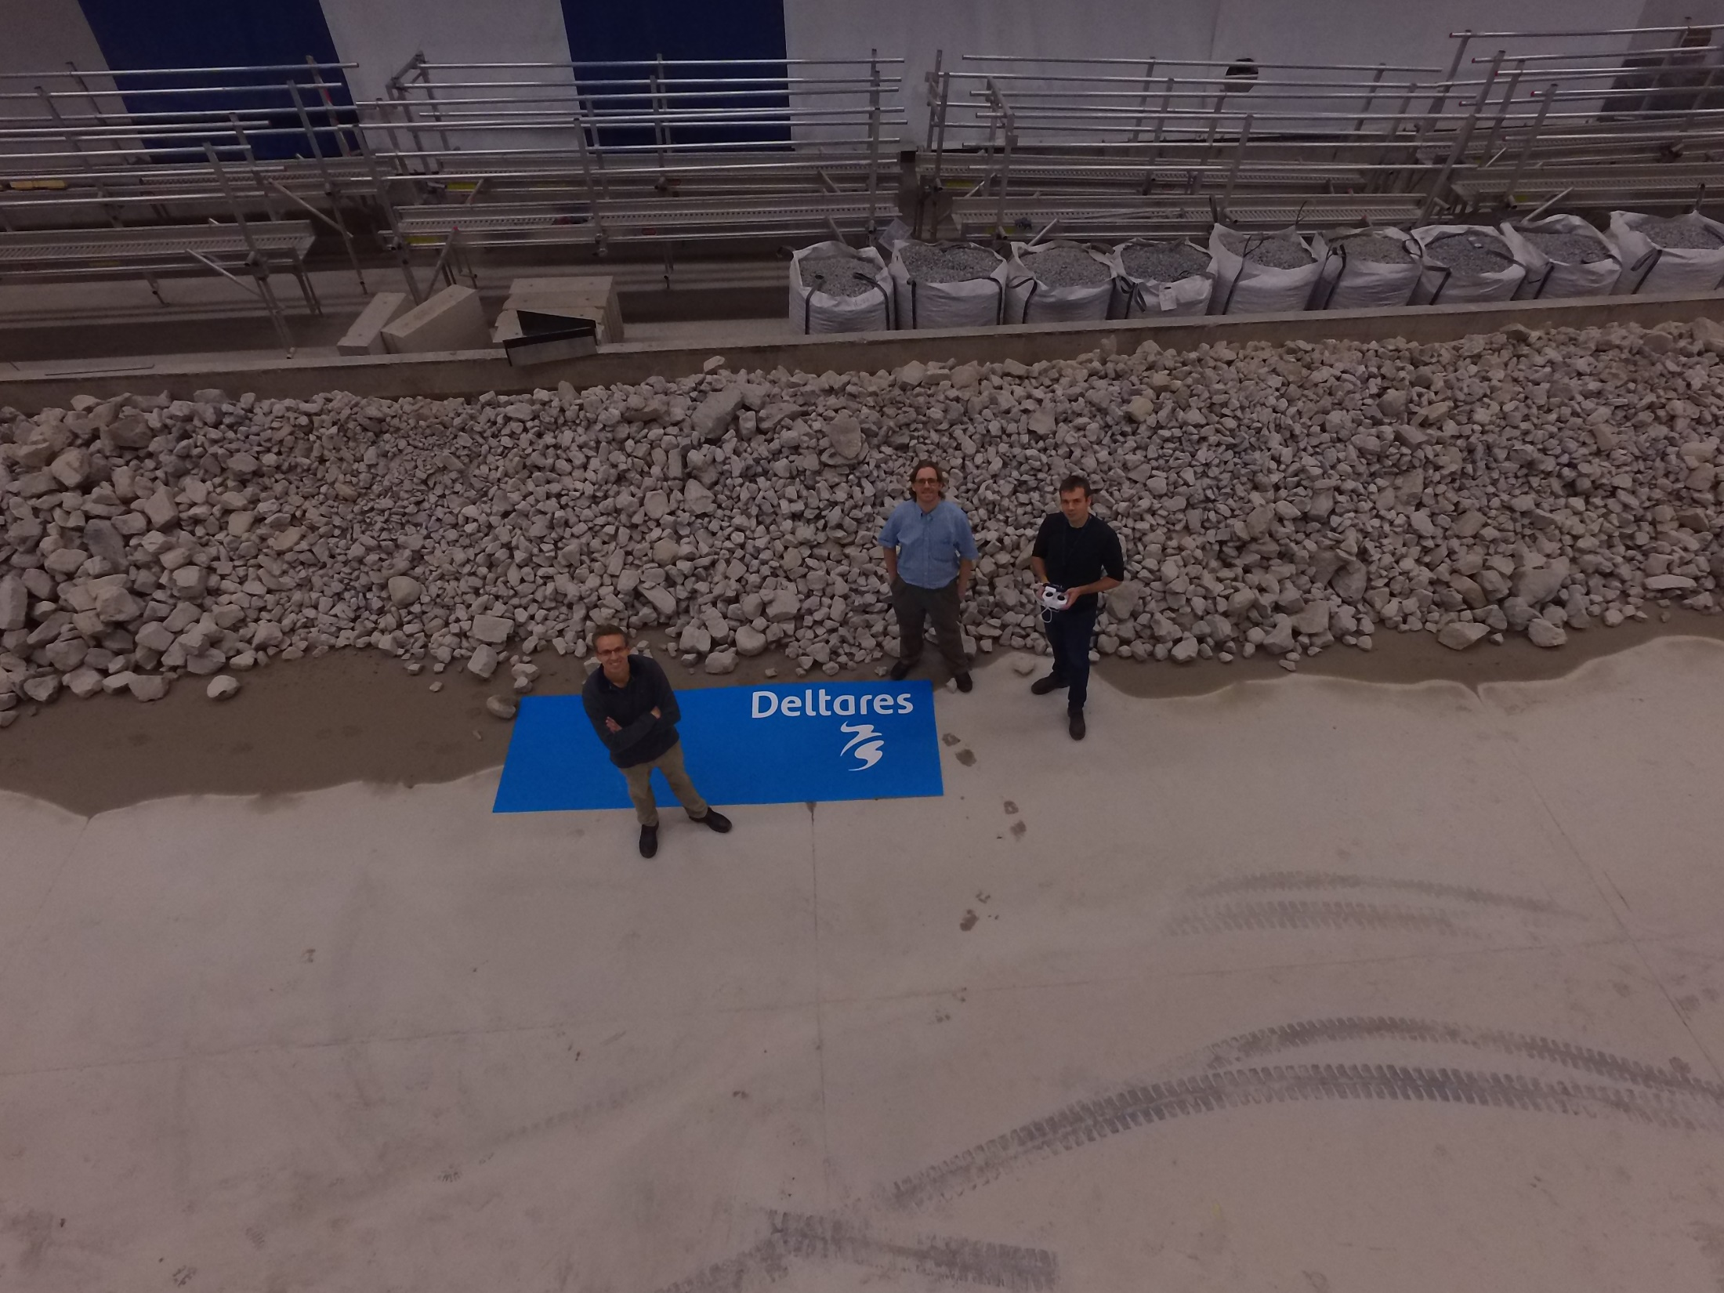

Slide 80


Slide 81
Break out to 3D Model

Slide 82
Questions

Slide 83
Stephen Mather, GIS Manager, Cleveland Metroparks
@smathermather, svm@clevelandmetroparks.com

